Slide 1


Intro to Git
Basics,setup and how to

Slide 2
Overview
Intro to problems solved by source control
Brief overview and history of Git
Basic Git commands and workflow (add, commit, and push)
Overview of expanded ideas (clone, merging and conflicts, branching)
Practical examples
Setup of GitHub app
Hands on experience

Slide 3
Projects without source control
In the past, you’ve probably written code or some other type of project and saved it to a flash drive.
If the project stayed on your flashdrive. Changes were pretty straightforward. As soon as you copied the project to another machine or got another person involved, changes became more tedious.
There is a good chance you lost track of which copy of the project was the most recent. If your partner made changes, you would also have to rectify those changes.
Imagine copy/paste updates with a team of developers.

Slide 4
What is Git?
Git is a source control system.
What is source control
“…is the management of changes to documents, computer programs, large web sites, and other collections of information”. –Wikipedia
Source control is also called version control and revision control.
Older source control methods allowed users to check out a file from a file server, but that file become locked while it was checked out. This prevented 2 developers from modifying the same file at the same time.

Slide 5
What is Git?
Git was invented by Linus Torvalds (inventor of Linux)
Prior to 2005, the Linux community used BitKeeper as their source control tool. BitKeeper stopped being free to use. This prompted the Linux community to make their own source control tool.

Slide 6
What is Git?
GitHub is a website built around Git. Not only does GitHub host your code, but also allows you to see your code and who made changes and when.
GitHub also has a section on each repository called issues. This is where collaborators can communicate regarding issues and ideas for a project.
GitHub built a desktop app to help manage projects. While the desktop app makes certain tasks easier, most of what will be shown today will be through the Git shell.

Slide 7
Basic Git commands and workflow
git status
This is a basic command where the shell will tell you the current state of your local repository. As a part of Git workflow, this should be frequently used before other commands.
git add –A
This is the first step in sending an update to git. If allows git to locally see your changes. Any files added to the project are now visible to git (but only locally). When you use git add –A, any new files added to the project become tracked.

Slide 8
Basic Git commands and workflow
git commit –m “your message here”
The commit is a major concept in Git. It is a save point by which the code for the entire project can be defined. Your repository is ultimately a large stack of commits. The power of Git comes from being able to accept, revoke, merge and pull back commits.
Every commit requires a message, it will be a brief description of what changes are in your commit. Each commit also has a unique ID.
git push
This is the command that will add your commit(s) to the repository, making your local changes apart of the remote repository. More simply put, it sends your commit into the cloud.

Slide 9
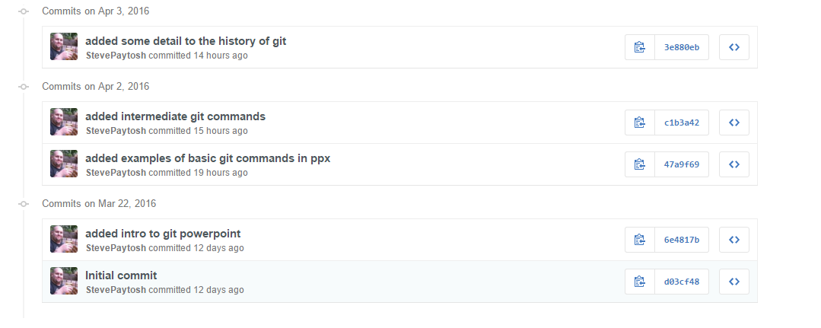
The commit history of the git_session repository as seen from GitHub. The same history can be viewed from the shell using git log.
The numbers on the right side of the commit can be used to send your repository back in time and view the code as it did with this commit.

Slide 10
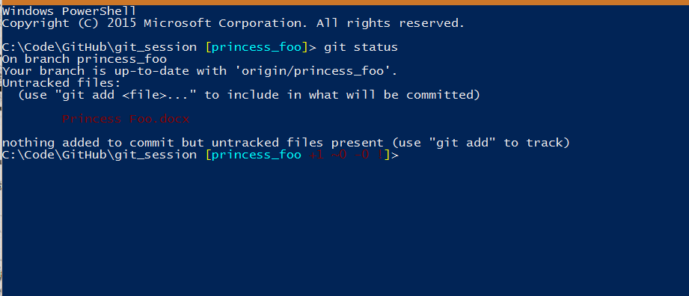
Examples of basic Git commands
Repository already contains a text file version of Princess Foo. Examples show addition of .docx version of the same text.

Slide 11
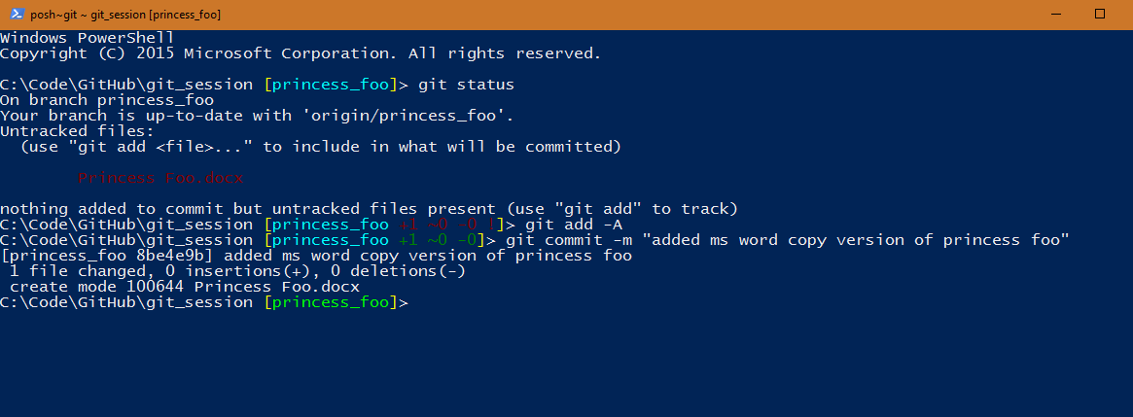
Examples of basic git commands
With the .docx version added, we can make a commit for it. Is it worth committing here?

Slide 12
Examples of basic Git commands
When we feel compelled that our changes should be added to the remote repository, we push our commit(s).

Slide 13
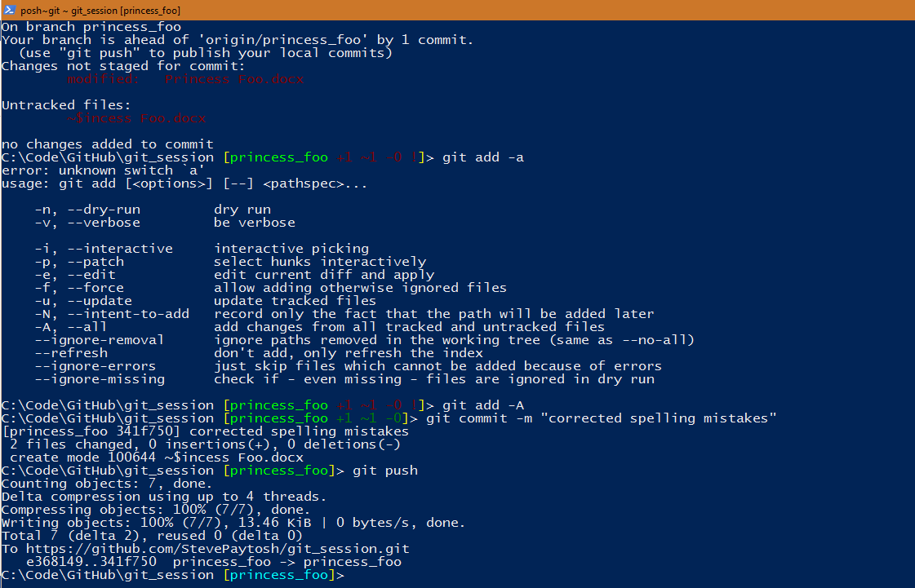

Slide 14
Intermediate Git commands
Add, commit and push are the basics commands of Git and represent just the bare minimum needed to use Git.
Branching
Code can be branched off, so that changes on one branch do not effect another branch. This is useful for adding new functionality or attempting to debug a major problem without destroying your current version of code.
Merging
Merging is the act of rectifying the history of 2 separate branches. When 2 braches are merged, the code from one branch is added to the code of another.
Cloning:
This is the act of pulling down an existing repository. This can be more easily done using the GitHub app.

Slide 15
Intermediate Git commands
Branching:
git checkout <branch name>
git checkout lets you traverse between branches. When you switch branches, the code in your folders will change automatically.
git checkout –b <branch name>
This command lets you create a new branch on your machine. When you create the new branch, it will automatically jump to the new branch.
git push –set-upstream origin <branch name>
When you create your branch, the remote repository doesn’t know about it. So we have to push the new branch to the remote repository.

Slide 16
Intermediate Git commands
git pull
Pull is more of a basic git command, but isn’t required. Pull is the opposite idea of push, think pulling something down. Pull simply updates your local repository based on what's in the remote repository. So if your team-mate tells you that they just pushed an update, you’ll want to run git pull.
Merge conflicts are disagreements in content based on the line of code. If user A changes a particular line, and user B pushes up a change to the same line, user A will encounter a merge conflict when pulling the changes made by user B.
It is worth noting that git pull is actually 2 commands in 1. It does the work of both git fetch and git merge.

Slide 17
Intermediate Git commands
The act of merging 2 branches must be done carefully. Merge conflicts can easily occur.
git merge <branch to merge in>
When you are on a branch, you can merge in another branch by using git merge.
When merging it is best to merge the higher level branch into the lower level branch first before merging the lower level into the higher level branch.
Pull Requests are formal merges. This can be done in the shell but is best done on GitHub. When working on a group project, it is best to pull request into master instead of merging. A Pull Request allows you to describe changes made in a branch to that they can be reviewed before the request is accepted and the branches merged.

Slide 18
Intermediate Git commands
Deleting a branch
Branches aren’t typically permanent. So once you are done with a branch, you can delete it. You can do a local delete which won’t remove it from the remote repository. You can also do a remote delete (tread lightly).
git push origin –delete <branch name>
This allows you to delete a remote branch, there are other commands that allow this as well, but this is the most simplified version. Deleting a remote branch will also delete the local branch.
git branch –d <branch name>
This will do a local delete of a branch. Using the lower case d switch will cause git to check if your branch has been merged or not and warn you if it hasn’t.
git branch –D <branch name>
This will do a local delete of a branch. Using the uppercase d switch will cause git to NOT check if you branch has been merged. This means that you are doing a forced delete of the branch.

Slide 19
Intermediate Git commands
.gitignore
Git ignore file is a list of document types that git should ignore. If the file type shows up in your local repository, it won’t be tracked by the remote repository. There are special rules that apply when a file type exists before a git ignore file excludes that type.
Forking
If there is an existing repository, you can make a copy of the repository that is unique from the original. You can update this forked copy without modifying the original repository. If you make a change that you feel the original code should have, you can make a pull request from you fork to the original repository. Forking is different from cloning in that you are making a brand new repository that is being filled with preexisting code.

Slide 20
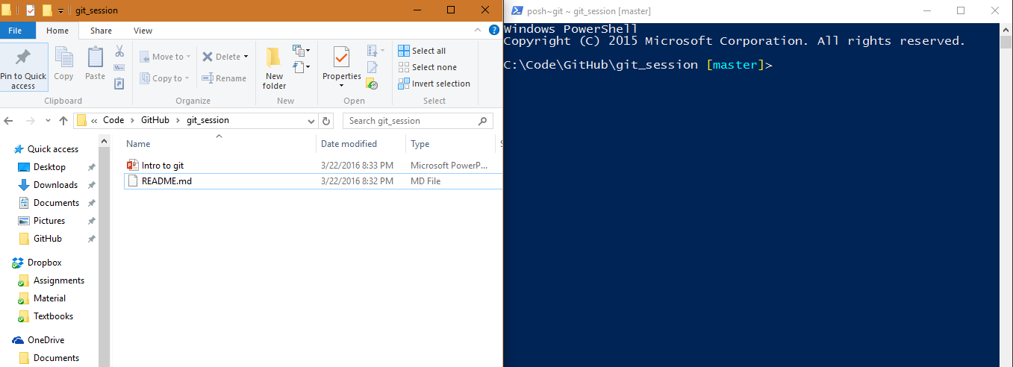
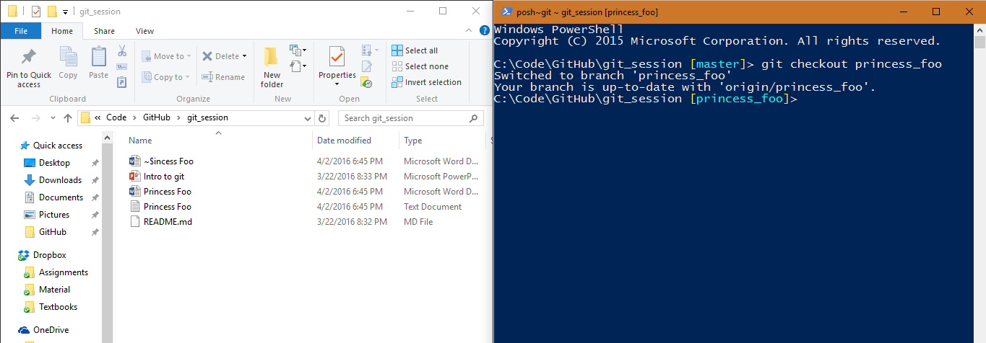
These two images demonstrate that the content of your files physically changes when you switch branches. On the left you can see the folder where the project is housed.

Slide 21
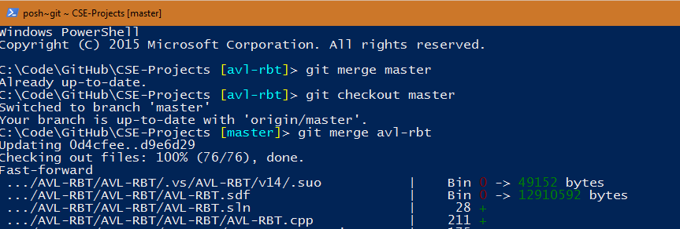
Using the repository for all my CSE projects. I made a branch for a project called avl-rbt. Once I turned in the project, I merged the branch into master. First I merged master into my branch. It was already up to date with master, so nothing happened. I switched to master and merged in my branch.
If this were a work related project. I would have merged master into my branch and then made a pull request to merge my branch into master.

Slide 22
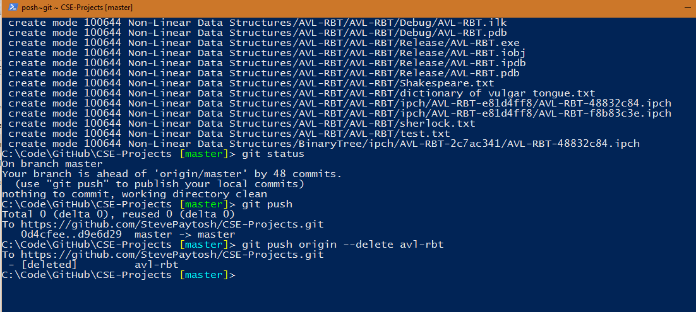
Once I merged my branch into master, I no longer needed the branch. I wanted to delete the branch, but first I felt it was important to push my merge first. Since the repository didn’t know about the local merge, I had to use git push.
With the merger pushed up I was ready to delete my remote branch. So I used
git push origin –delete avl-rbt.

Slide 23
GitHub setup
Sign up for a GitHub account:
https://github.com
Use any email address to sign up.
GitHub participates in the student developer pack. As a student, GitHub will give you several free repositories.
You can add your Toledo email address to your profile on GitHub.
https://education.github.com/pack to sign up for your student developer pack.

Slide 24
GitHub setup
Download and install the GitHub desktop app:
https://desktop.github.com/
The download includes the desktop app as well as the Git shell.

Slide 25
Hands on exercise
Pair up with one or two people.
One person should fork the repository from my GitHub
https://github.com/StevePaytosh/git_session is where you can view the repo.
At the top right of the page, click fork. This will create your own copy of the repository.
Go to your copy of the repository on GitHub and in the top-middle area click settings.
Click collaborators and add your partners to the repository.
Once everybody is added to the repository, clone a copy of it to your desktop from the app.

Slide 26
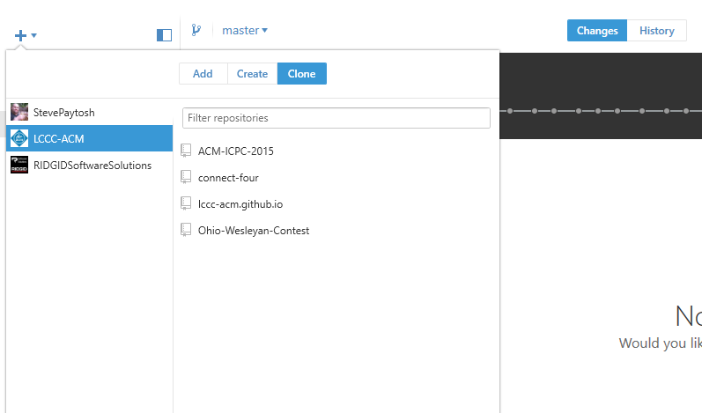
Hands on exercise
In the github app, you can click the plus sign to clone a repository to your machine.

Slide 27
Hands on exercise
Once everybody has cloned the repository to their machine, they should open up the git shell by right clicking the name of the repository.
The basic exercise will be for each team member to write an addition to the Princess Foo story. Each team member should switch to the princess_foo branch and then create their own branch. Immediately push your new branch to the remote repository.
Everybody should take 1 part of the story to write or rewrite. Write as much content and make the story take whatever turns you want. As a rule, commit and push after each paragraph.
When you wish to finish the exercise, merge princess_foo into your branch. If you do not own the repository, create a pull request on GitHub to merge your branch into princess_foo. If you own the repository, simply merge your branch into princess_foo.

